Slide 1
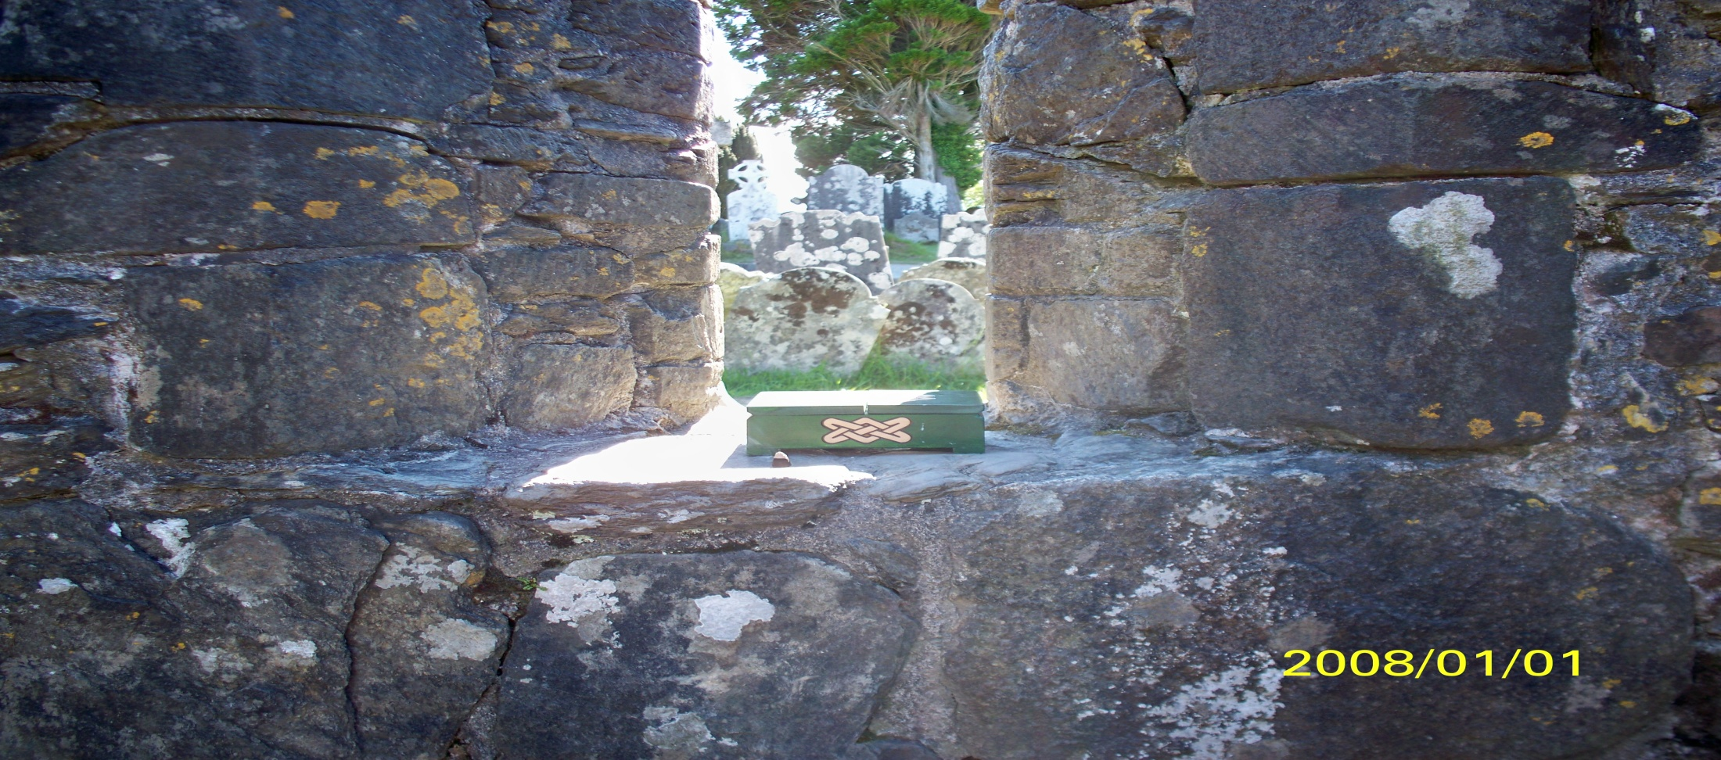
Creating Sacred Space at the End of Life

Slide 2
Mindmap
Background
What is “ SACRED” ?
Death-dying
Ritual
Miscellaneous input
(My approach)
Dyad session
Group sharing
Moving ahead

Slide 3
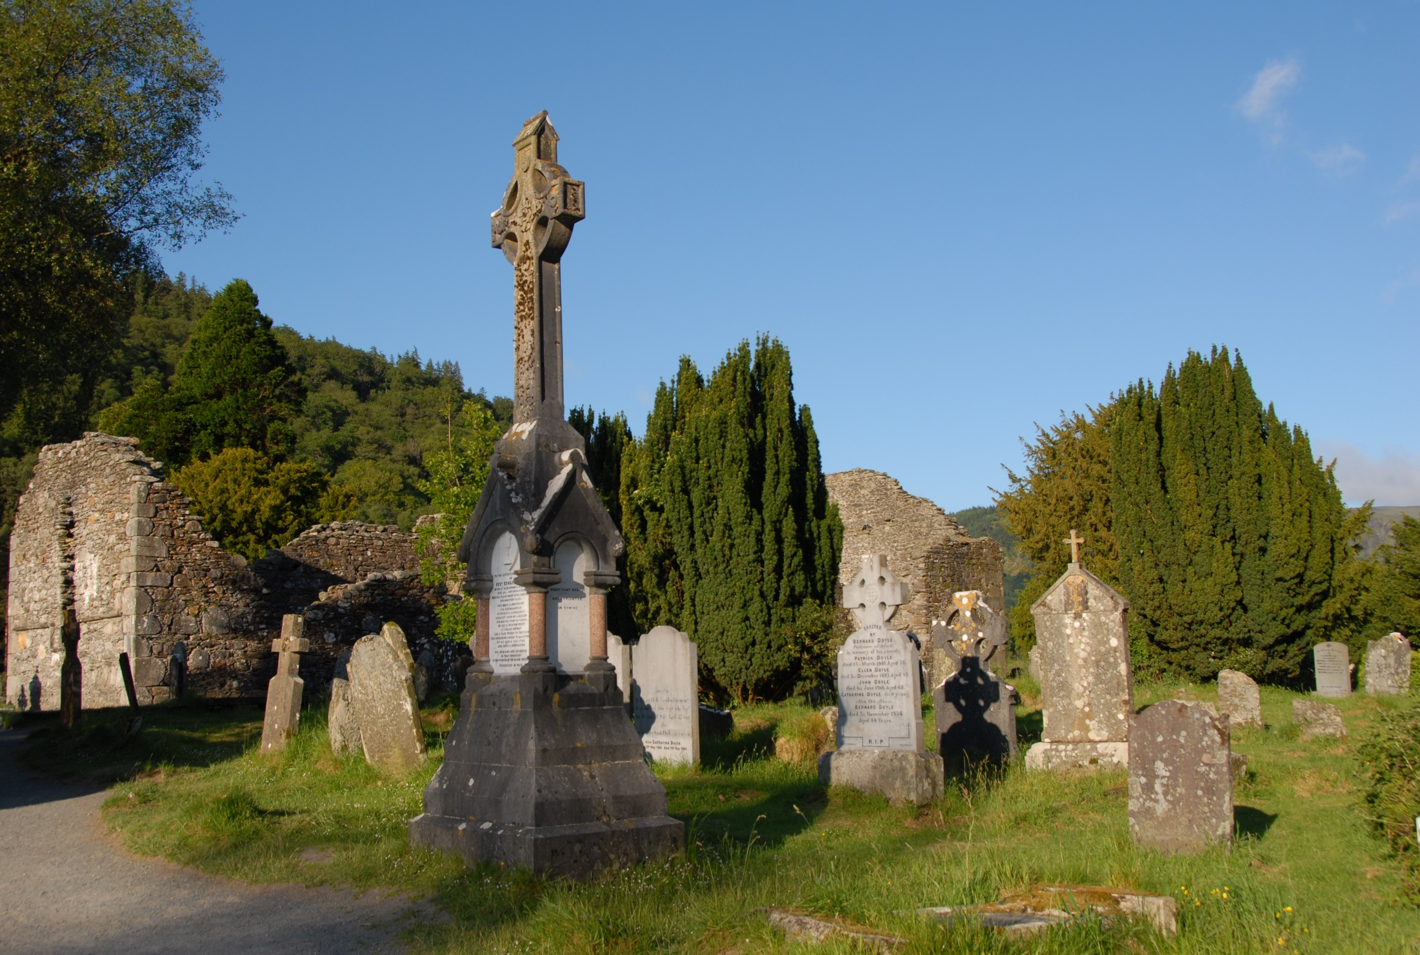


Slide 4
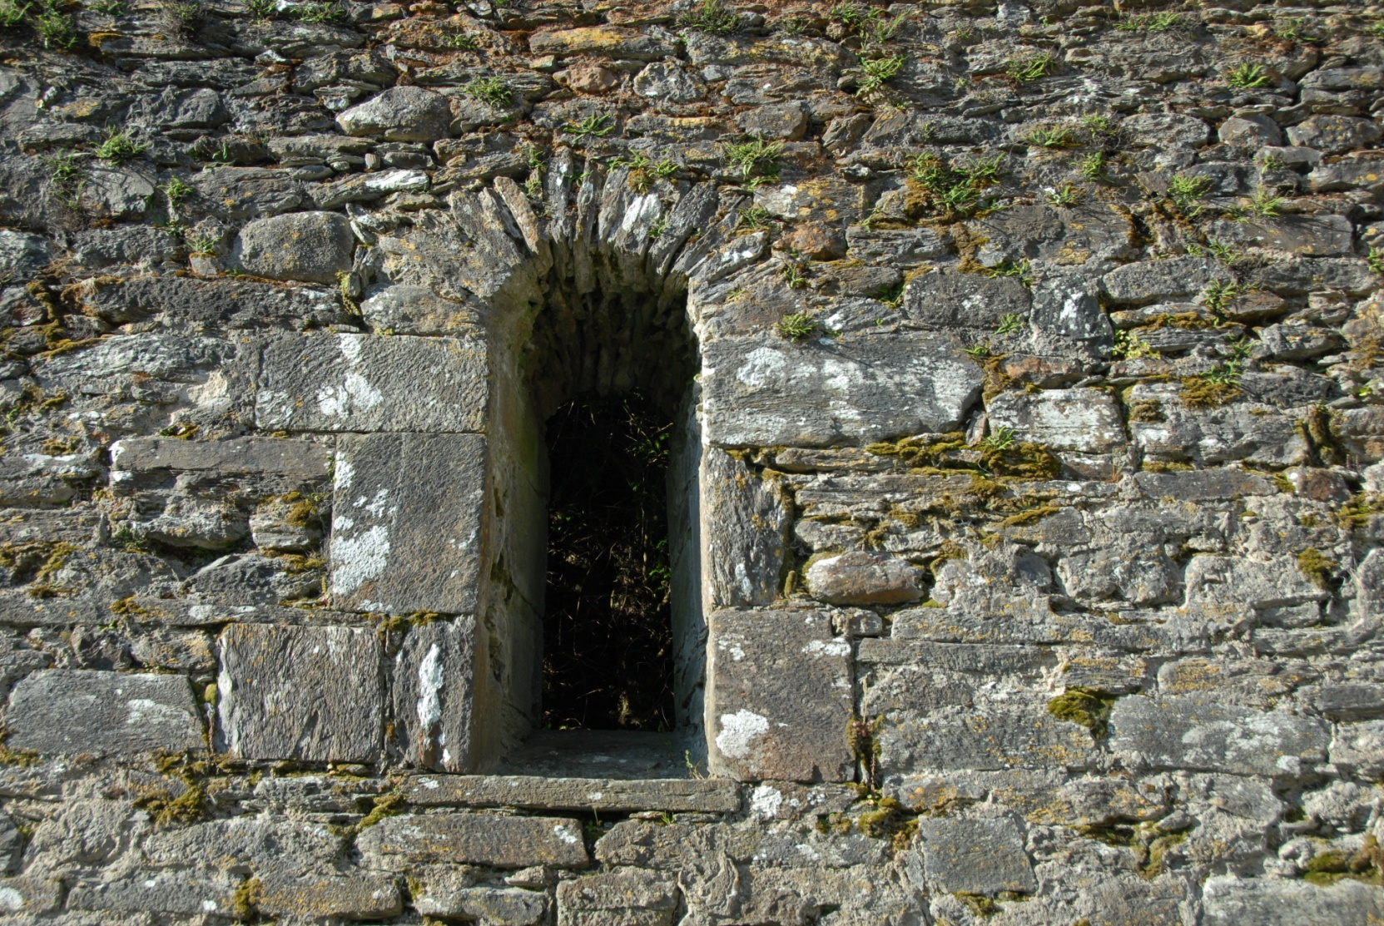
Dying is like…

Slide 5
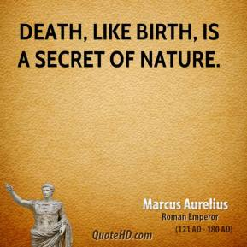
Dying & Birthing…

Slide 6
The dying process…
Loss of vital energy
Changes in breathing pattern
Changes in nervous system
Changes in circulation and temperature
Changes in appetite
Change in bowel and bladder
Changes in “emotion”
Changes in language
Changes in comfort

Slide 7
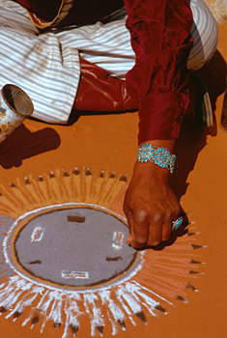
DYING IS A PROCESS OF TRANSFORMATION…
THAT REQUIRES MORE THAN PAIN MANAGEMENT AND SYMPTOM CONTROL. WHEN WE ONLY USE THIS MODEL, WE RISK MISSING THE SACRED.
Notes:
WEAVE
Weaves back to “the dying are our teachers.”

Slide 8
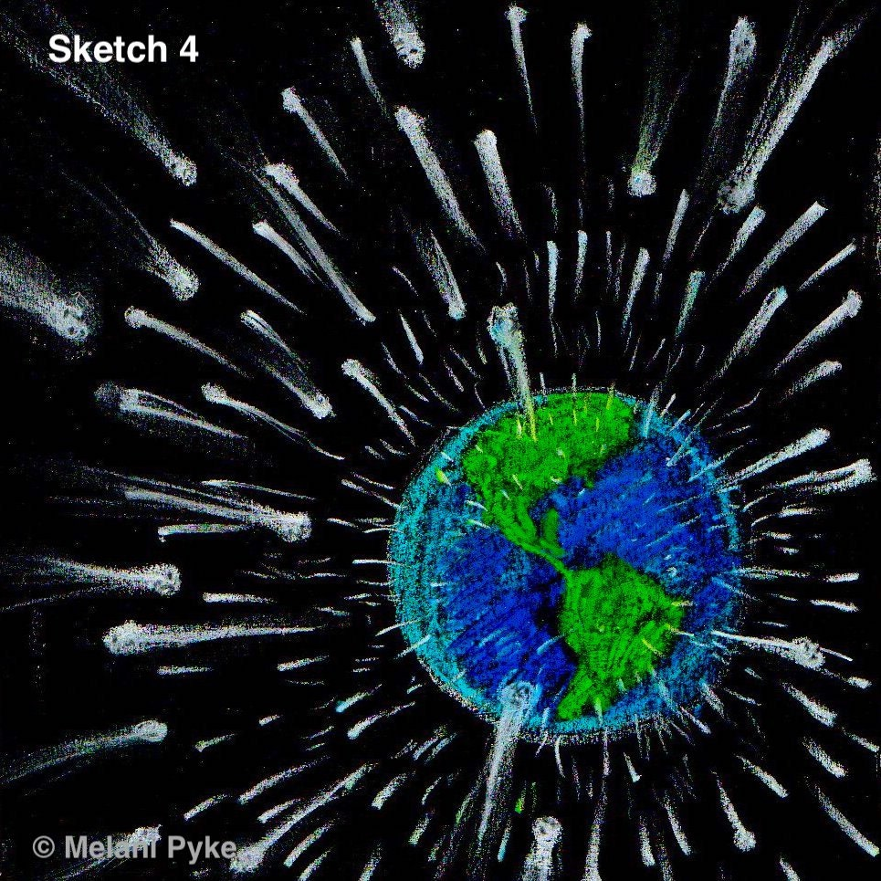

Slide 9
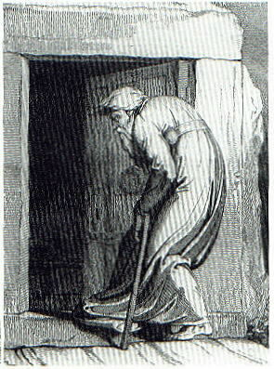
THRESHOLD
A
WAITING
PLACE

Slide 10
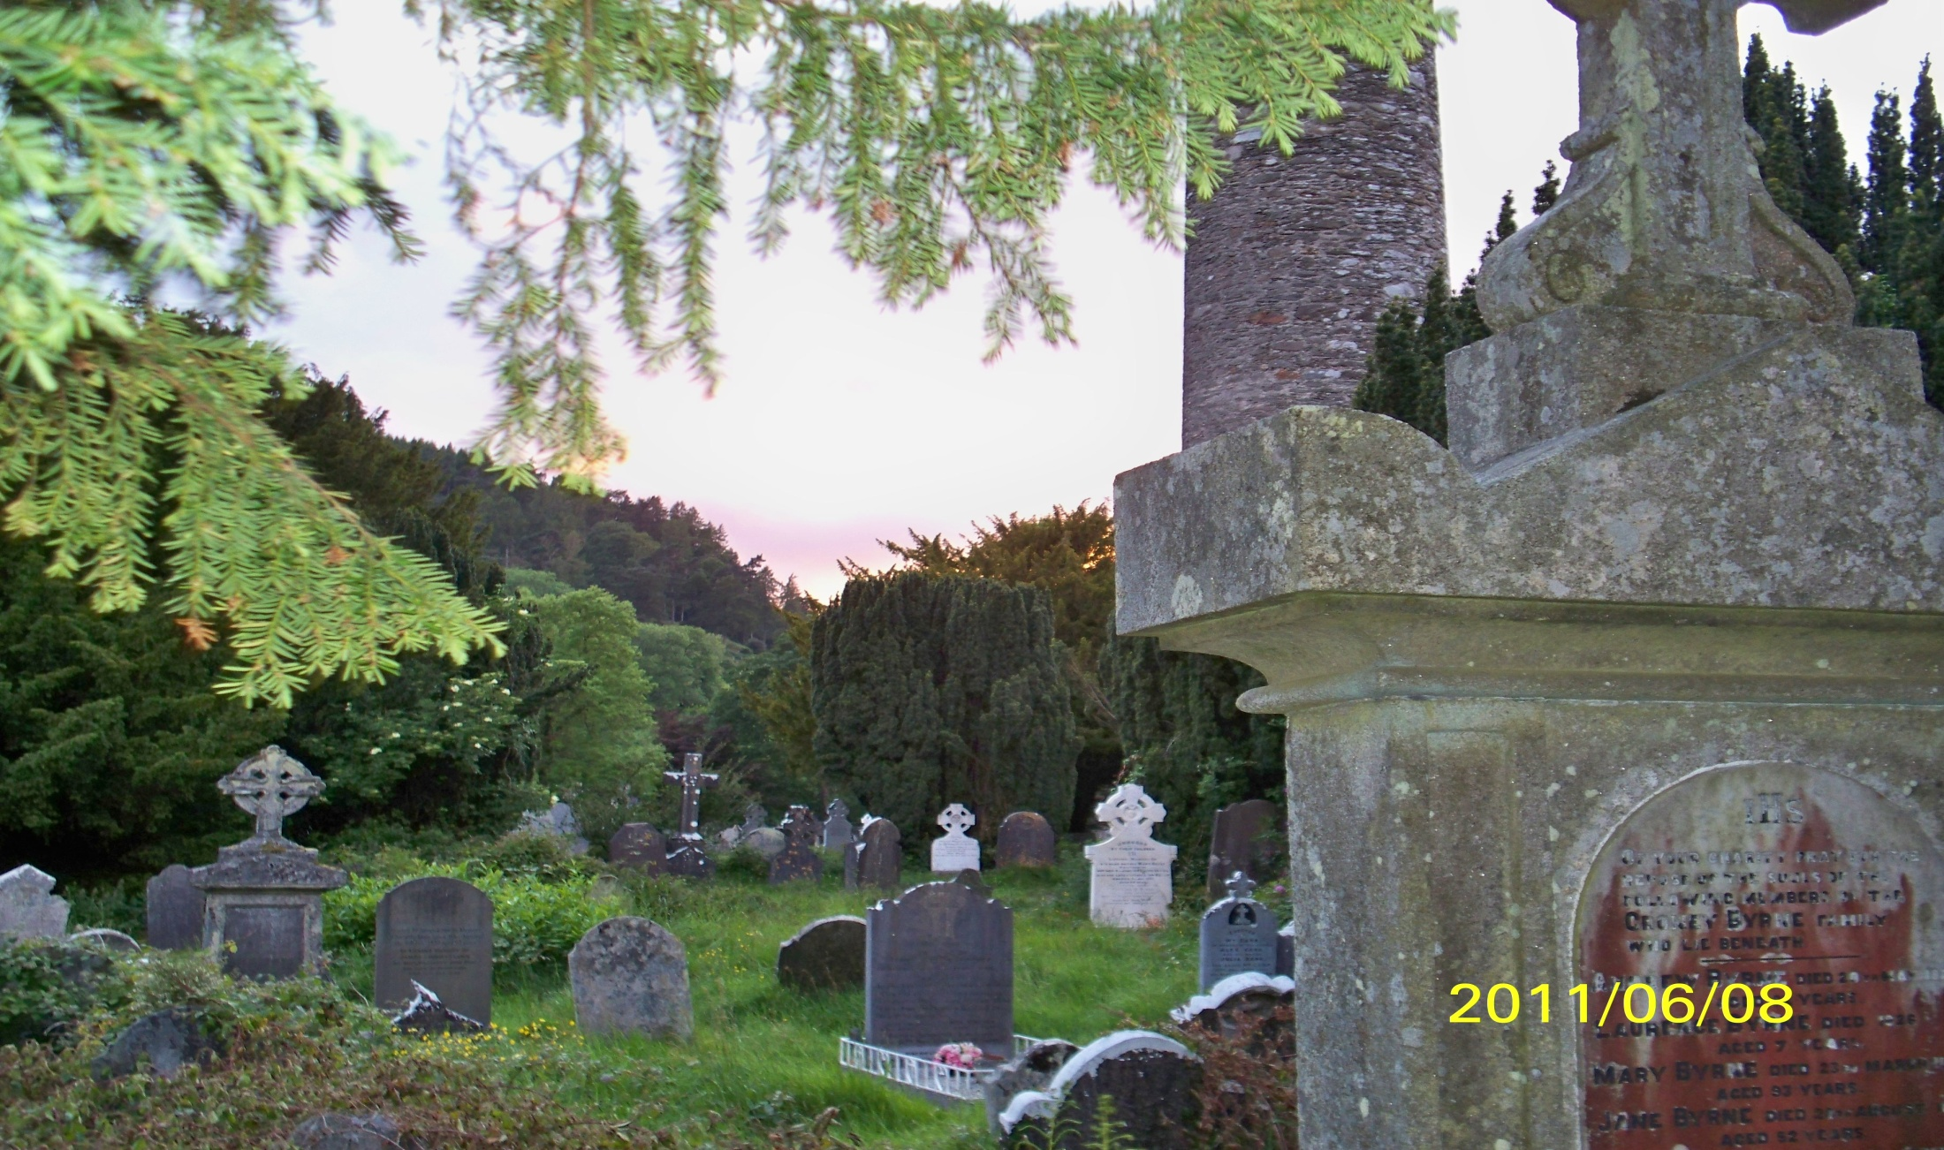
Background

Slide 11
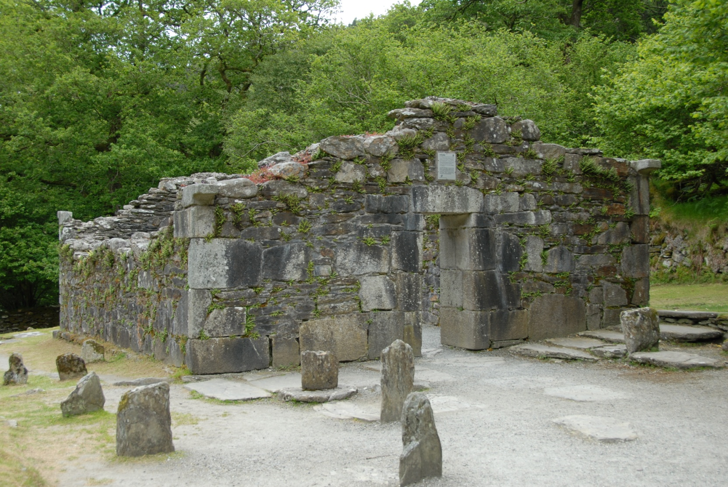
What is your definition of “sacred”?

Slide 12
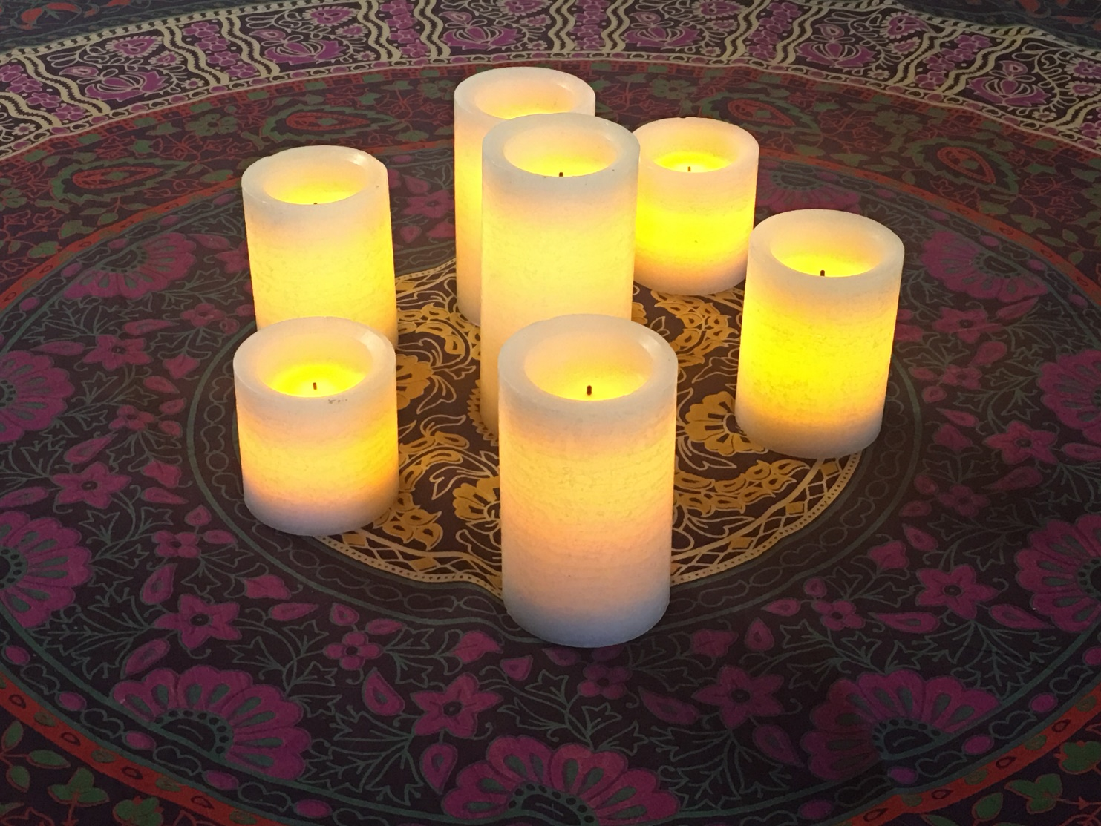

Slide 13
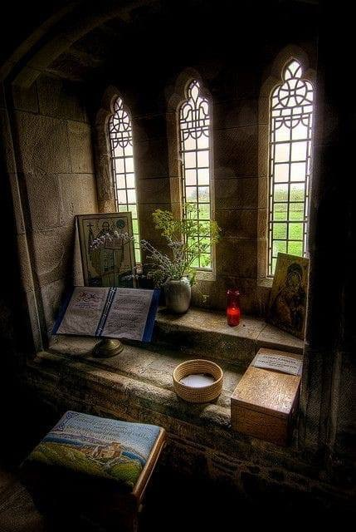

Slide 14
“ Sacred”
“ The Sacred and the Profane : The Nature of Religion” – Mircea Eliade
Profane space is the world in its natural state, the common world; people live without any special regard to their surroundings
Sacred space is that “other world”; beyond the universe; that “something” on the other side of everything we know

Slide 15
“ Sacred”
When sacred enters the “real world”, that sacred space is ordered… a reflection of the cosmos…connected to the transcendent.

Slide 16
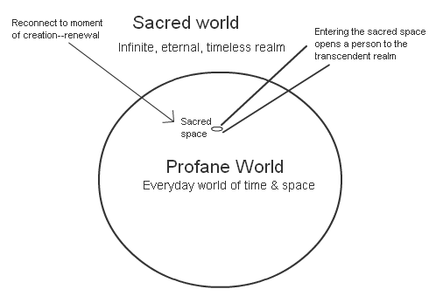
“Sacred”

Slide 17
THE THREE WORLDS
THIS WORLD
Cruinne
MIDDLE WORLD
Alltar
OTHER WORLD
Nearth
SILENCE
NATURE
PSYCHE
SILENCE
Goal: To live in all three worlds simultaneously
Notes:
WEAVE
-Weaves back to the non-dual world view of the Celts
-Weaves forward to THE core teaching of this session that will be illustrated in both the Coma Communication and Guided Visualization workshops…

Slide 18
“Sacred “
“ Because of this, people’s behavior is often ritualistic in a sacred space, different from their everyday behavior. They may speak of a sense of reverence or quiet meditation. However they define it, people recognize that entrance into this sacred space allows them to tap into the transcendent for renewal and regeneration”

Slide 19
DEATH — DYING & RITUAL
AS NORMALCY RETURNS, NEED FOR RITUAL DECREASES
DEATH
LOSS
PATIENT MOVING TOWARD DEATH
FAMILY MOVING AWAY FROM DEATH
AS NORMALCY DECREASES, NEED FOR RITUAL INCREASES
SACRED (RITUAL) TIME
Notes:
WEAVE
-Weaves back to the essential connection between the SALAD series and end of life perspectives…
-Weaves forward to the special role of ritual in end of life care…

Slide 20
5 ELEMENTS OF RITUAL
STORY
SPACE
ACTION
COMMUNITY
SYMBOL
Notes:
WEAVE
-Weaves back to the importance in the Ars Moriendi of naming and defining ritual elements during profound times of transition…
-Weaves forward to the super structure of the afternoon workshop…

Slide 21
Community and Ritual

Slide 22
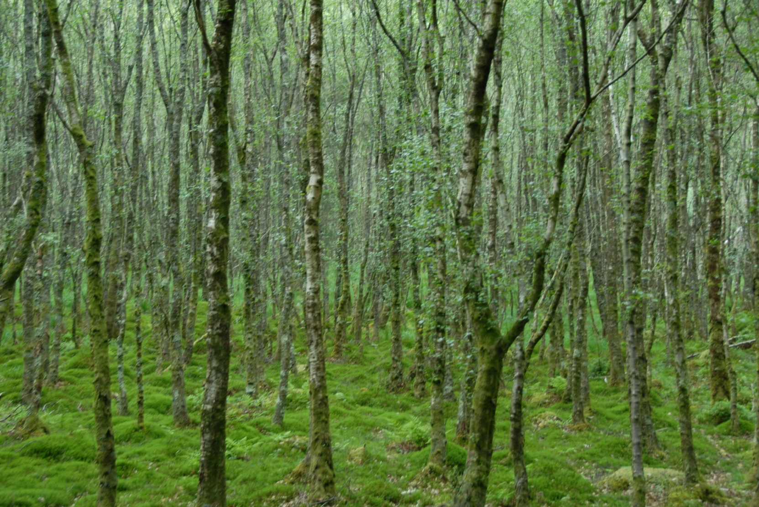
Irish wake…

Slide 23
Vigil
“A Constant Presence in a Sea of
Change”
Care of Families During End-of-Life Vigils
Colleen Fleming-Damon, PhD, ANP-BC, ACHPN, FT

Slide 24
Vigil
A ritual has been defined as a sequence of activities involving gestures,
words, and objects performed in a sequestered place and sequence of
time. (van Gennep,1960; Bell, 1997;Turner,2008).
Role of Vigil
Creates unity
Restores equilibrium
Constructs meaning

Slide 25
Vigil
Individually and collectively, families strive to create meaning as a
languaging, valuing, and meaning-generating group (Parse, 2009).
For families, meanings are significant interpretations and
understandings of actions, symbols, communication, activities and
human events within the contextual life of the family (Bell, 1997).

Slide 26
Vigil
Pre-vigil
A time of gathering
Death Awareness
Death Notification
Coming to Vigil
Vigil
A Time of Last Communion
Fluctuating Thoughts
Sea of Emotions
Intimacy of Caring Behaviors

Slide 27
Vigil
Post-vigil :
A time of transition
A Time of Loss
A Time After-Loss
A Time of Change

Slide 28
Vigil
EOL Vigil: Research Supported Assumptions
is a universally lived experience
convenes with awareness of approaching death
is being with another towards death
provides potential for family transition and change
is a complex, dynamic existential process
has the potential for outcomes of suffering or healing
is an opportunity with potential for action

Slide 29
Vigil
Overarching Existential Theme
Keeping vigil with a dying family member was described as: “Being a constant presence in a sea of change.”
A sea of change is defined as a situation or event that denotes a
substantial change in perspective, or paradigm shift. The “sea of
change” was evidenced by shifting patterns of time space, body and
relation as revealed in the study findings.

Slide 30
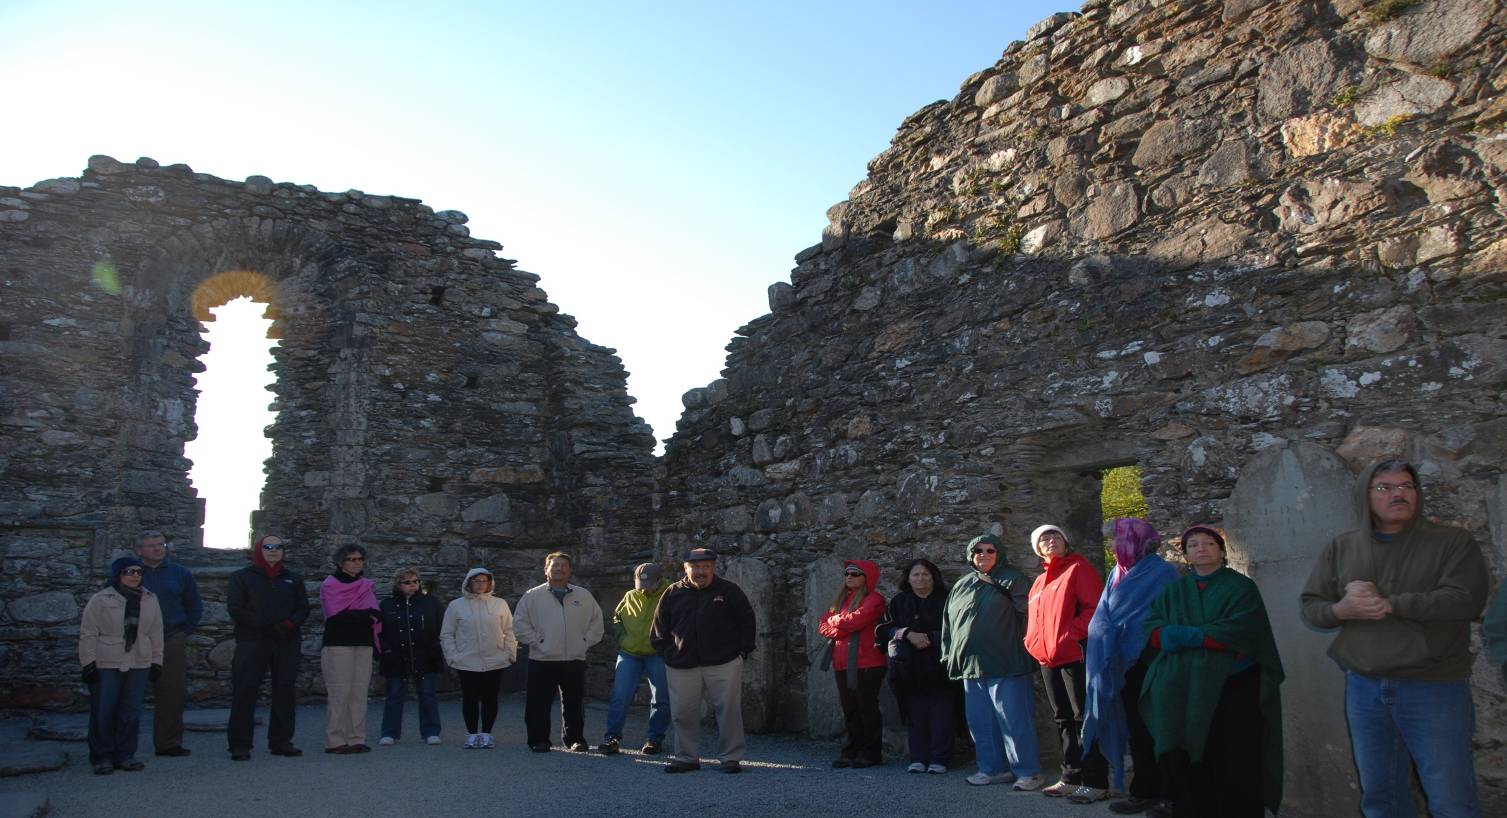
Other qualities

Slide 31
Other qualities
Community
Non-medical
“what would nature do?”
‘ letting go ‘

Slide 32
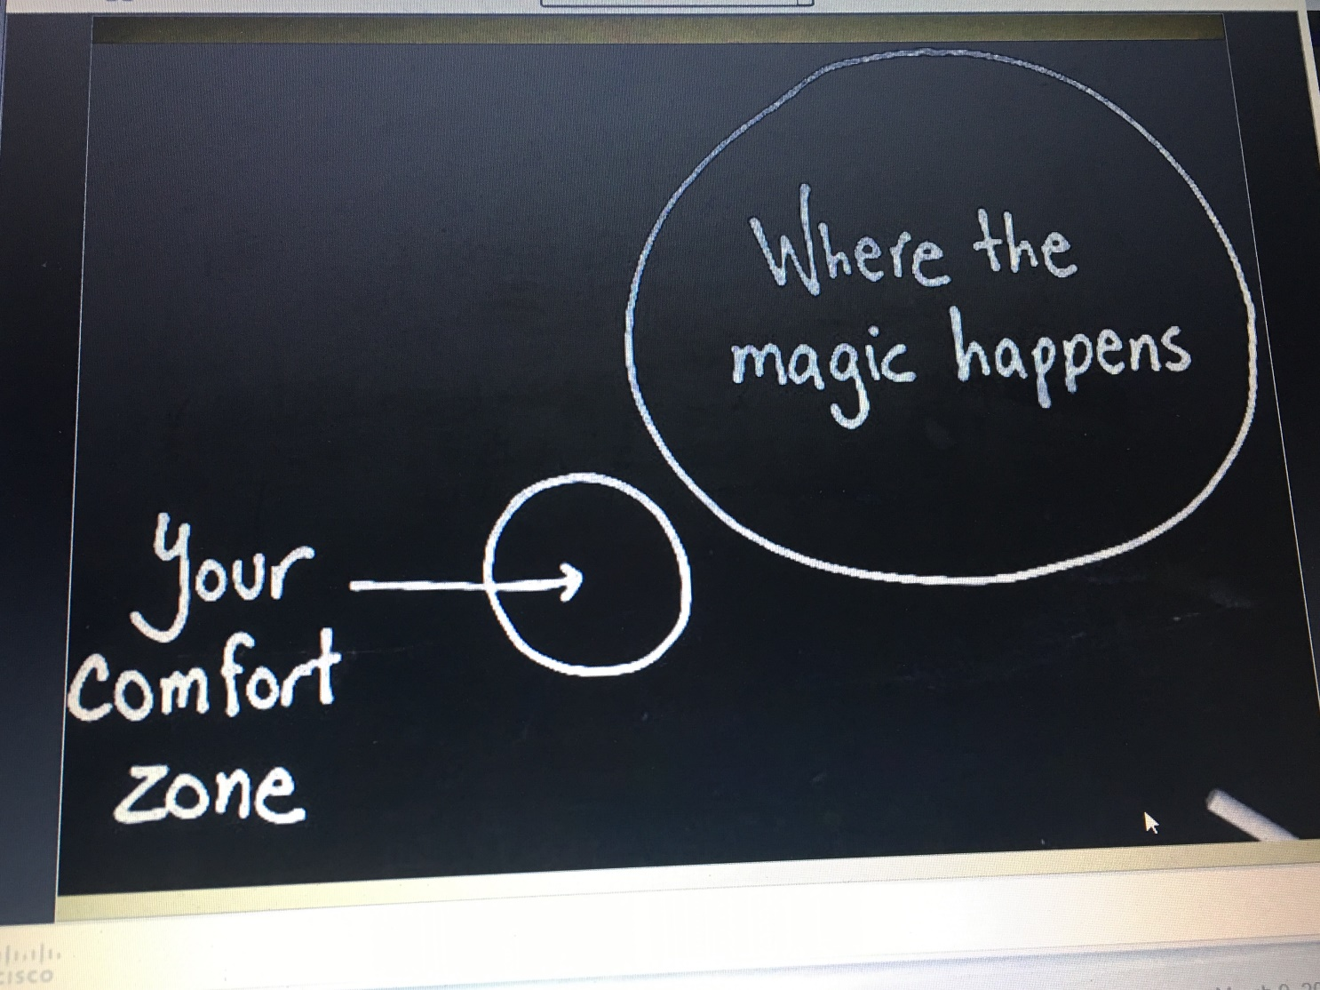

Slide 33
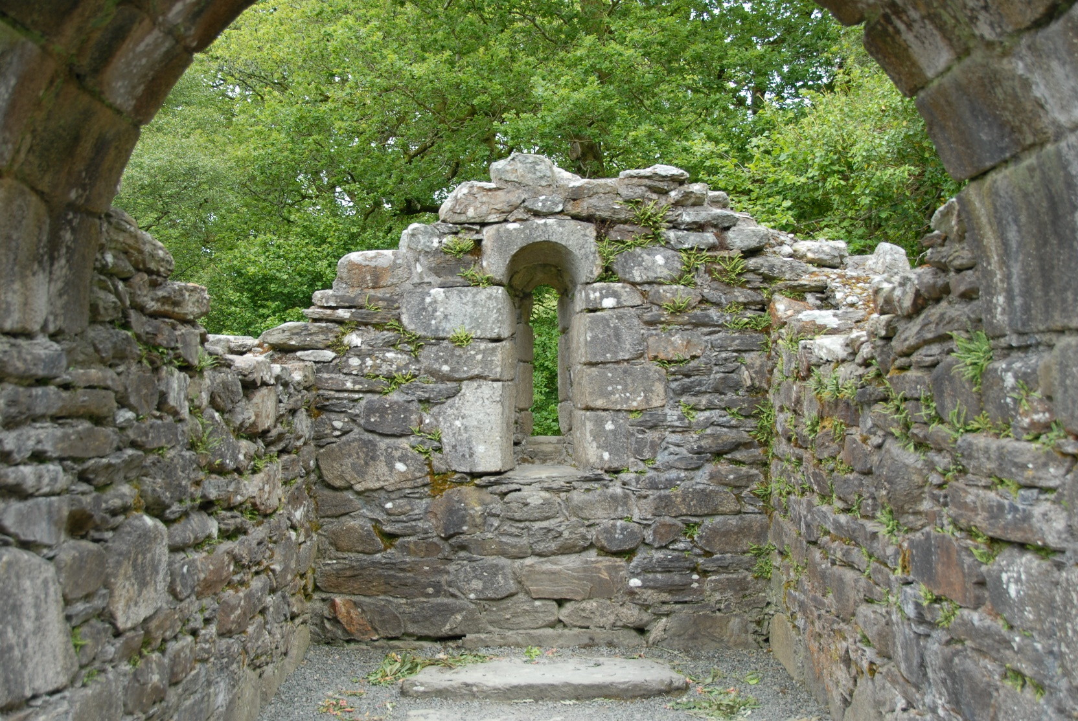
So, how as Anamcara do we approach it?

Slide 34
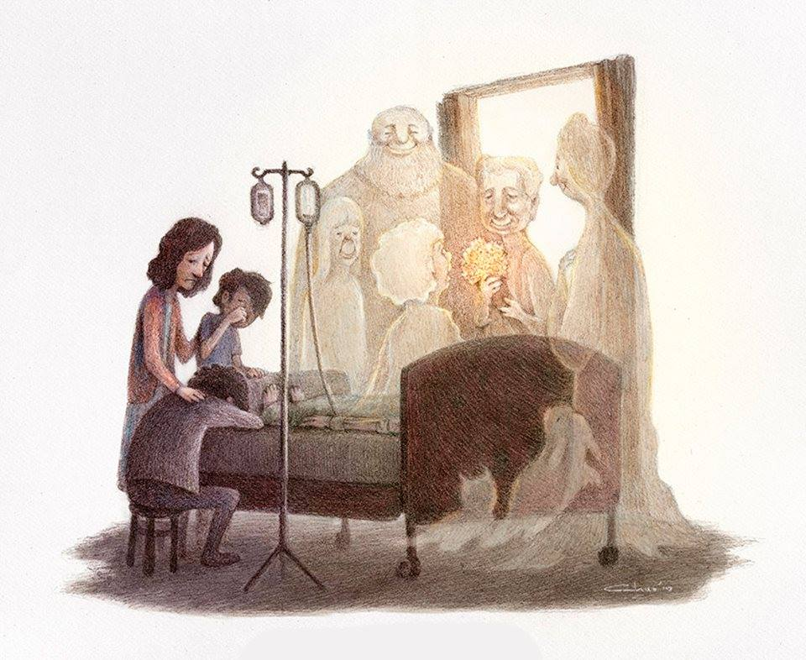
“Good bye and Welcome”

Slide 35
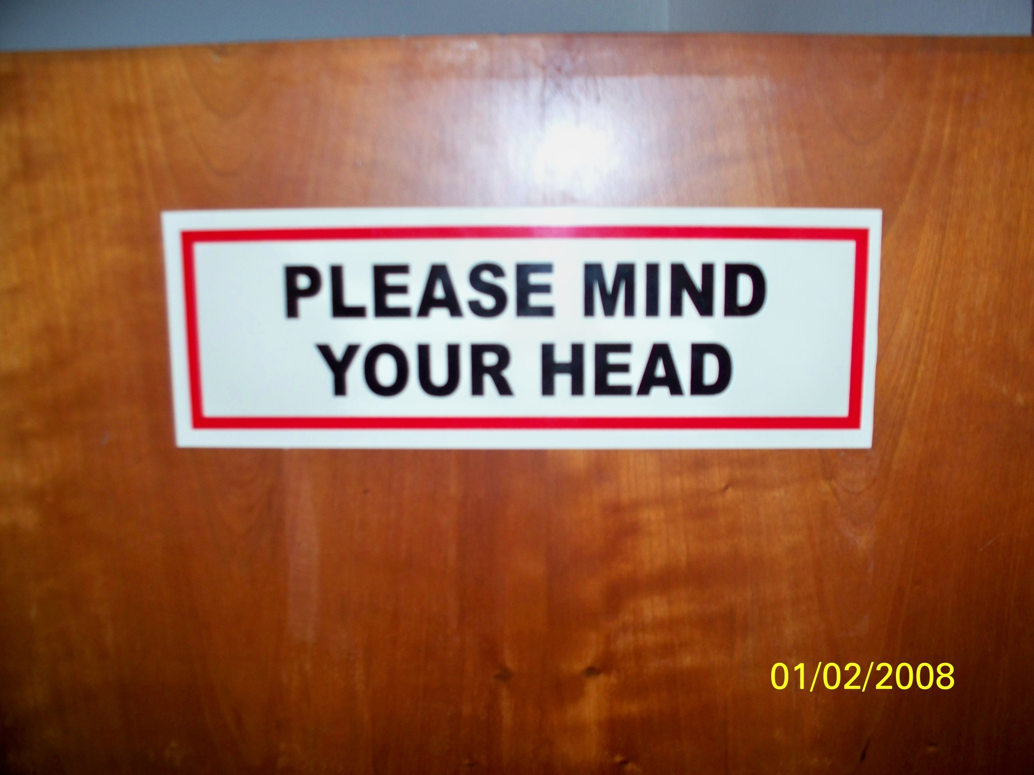

Slide 36
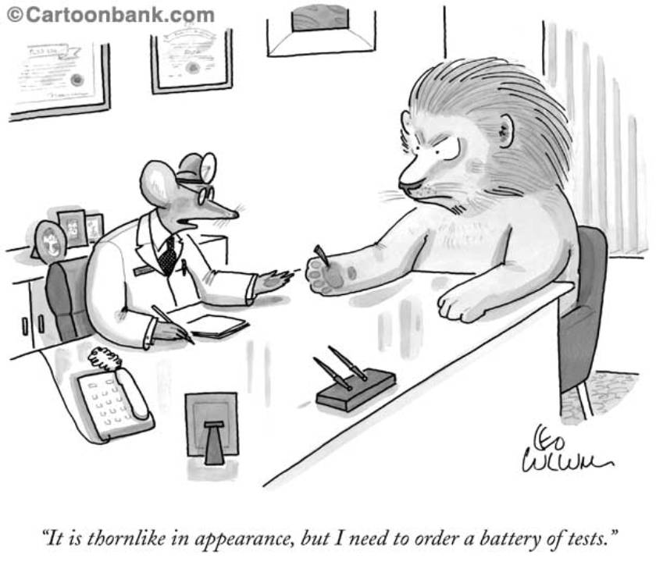
The Vignettes

Slide 37
My approach
We just need to pay attention
Awareness of the profane
Use what my (our) mentors have taught
Compassionate silence
Exquisite empathy
No expectation/no agenda
Model by example
Teaching to look with new eyes
“Hollow Bone”

Slide 38
My approach
Metacommunication
Breathwork
Deep listening
Silence
Coma Communication
Psalms, poems, metaphor

Slide 39
Other tools
Anoint the body
Limit stimulation
Clear the energy
Involve your spirit guides
Ritual
Ritual bathing
Epsom salts
Music
Massage
Crystals
Altar
“Watchers”
Reading/chanting
Evaluate the body

Slide 40
My approach 2
Recognize…
Honor…
Safeguard…

Slide 41
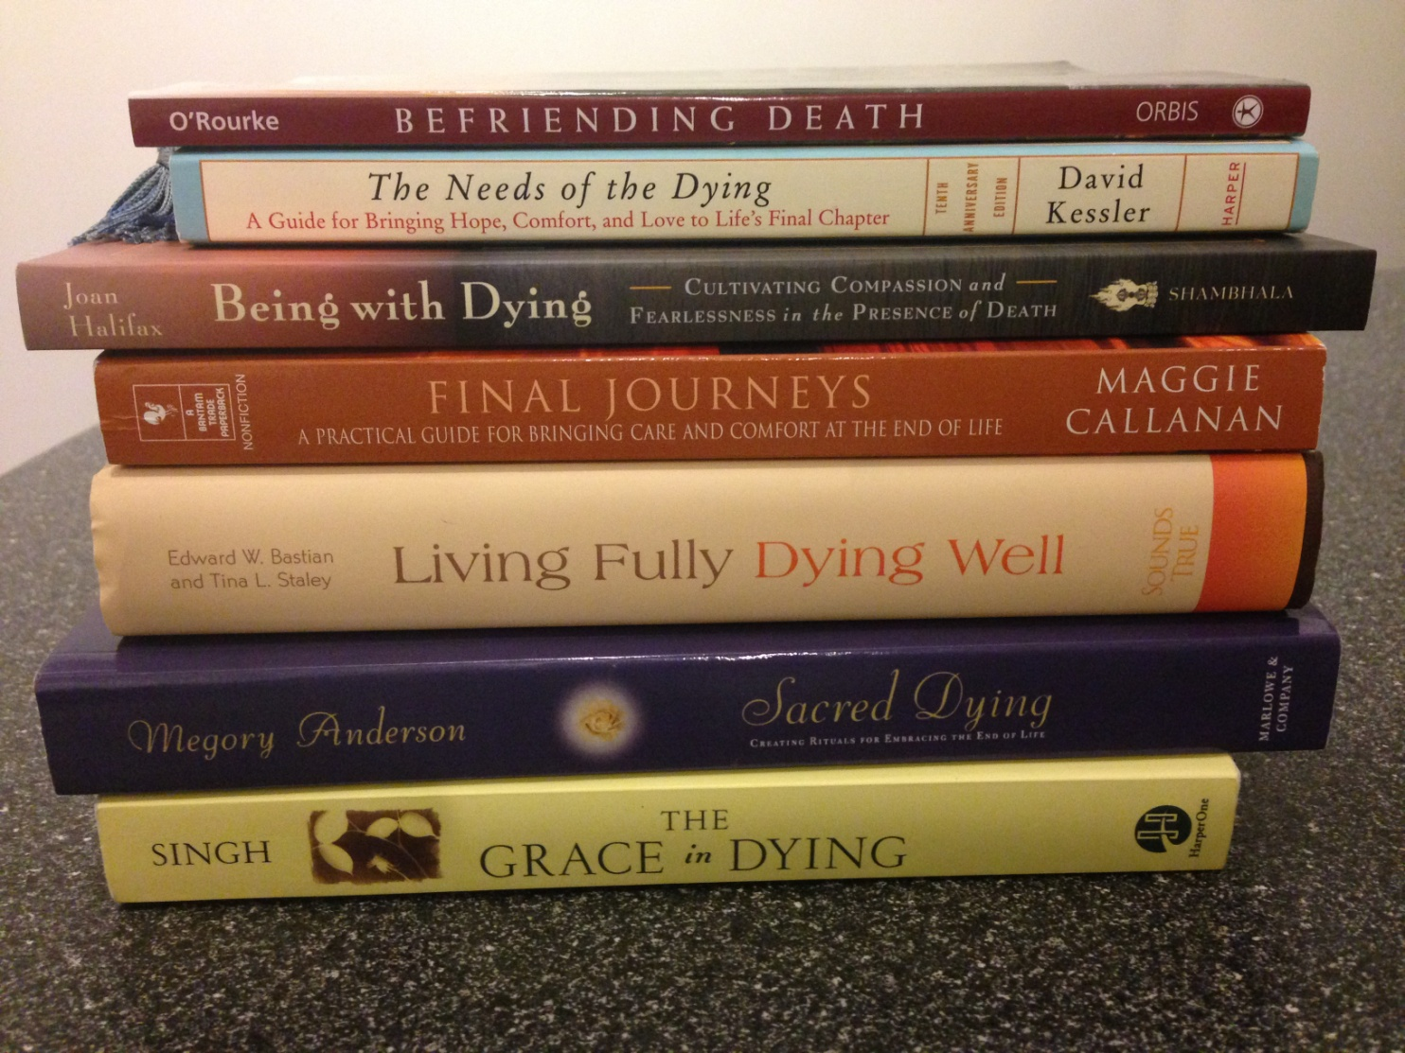
And of course…

Slide 42
Chrysallis room…
“Mother’s death was a supported, peaceful, natural death surrounded by loved ones and cared for with dignity and respect both before and after death. It was a spiritual process unfolding in sacred space, in the place she called home. Hers was, by all definitions, a very good death.”

Slide 43
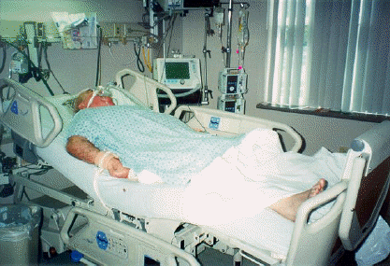

Slide 44
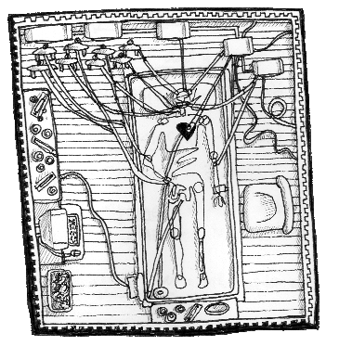
deathtrajectory

Slide 45
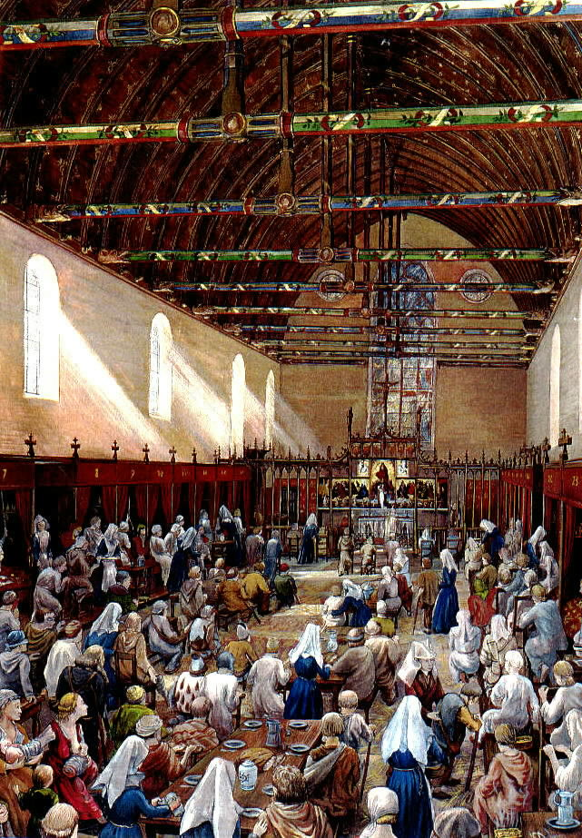
”ARS MORIENDI”
1000-1492 AD

Slide 46
ICU
Impossible
AAHPM survey
Colleagues experience ( NP )
Unplug / de-escalate / music
Virtual reality
OPPORTUNITIES – NOT OBSTACLES

Slide 47
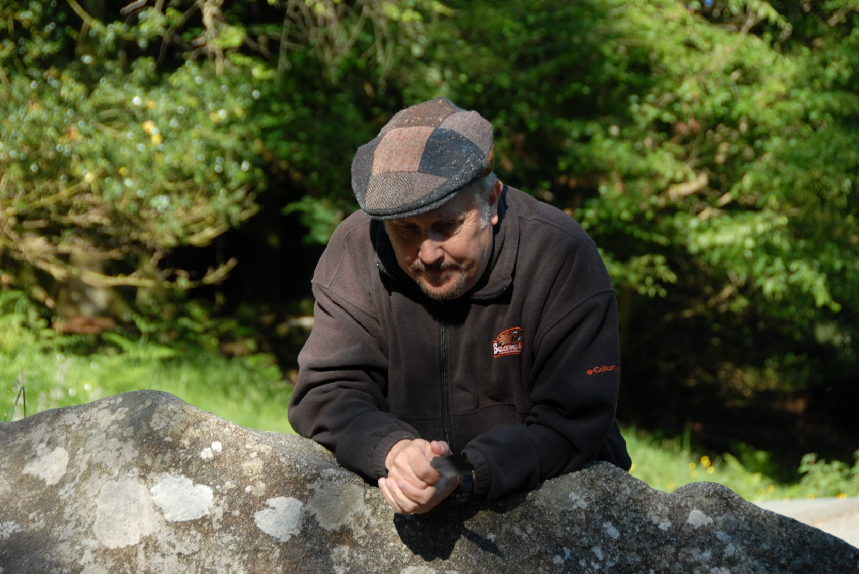
Dyad experience

Slide 48

We Are the Medicine
You are more than enough
“The cracks are there to let the
light in”
Blessed by your humanness

Slide 49
